Slide 1
Employee Directory Search
This feature can be included in an existing application.
Currently directory hold about 11,000 employees in the database but data retrieval is very fast. This feature was tested for more than 50,000 employees and works very well.
Accepts partial or full name searches.
When you click on any entry, it shows full organization structured and includes, sharable profile information such as Employee Name, Employee ID, Position Title, Department, Phone, list of people in the team, people who direct report, and organization structure to the top level.

Slide 2
Employee Directory Search
Screens are responsive so works well on smaller devices as well.
Search accepts enter key or user clicks on search button after typing in text to search

Slide 3
Sample Search Result: Matching partial match

Slide 4
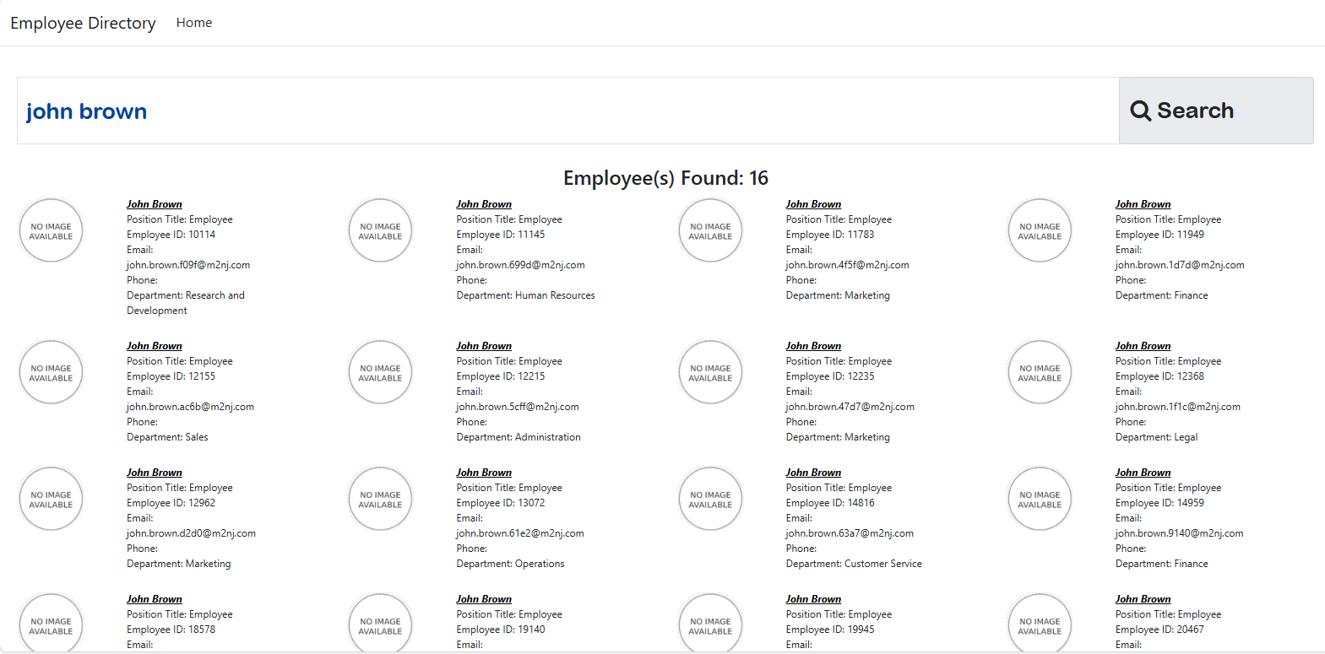
Sample Search Result: Matching full search

Slide 5
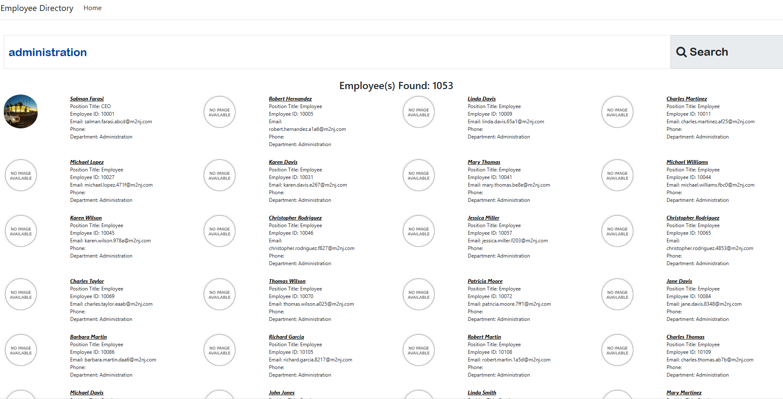
Sample Search Result: department search

Slide 6
Profile View: Sample 1

Slide 7
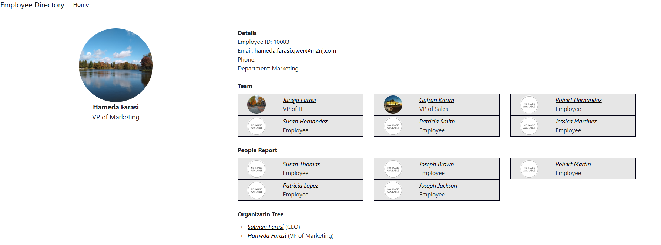
Profile View: Sample 2

Slide 8
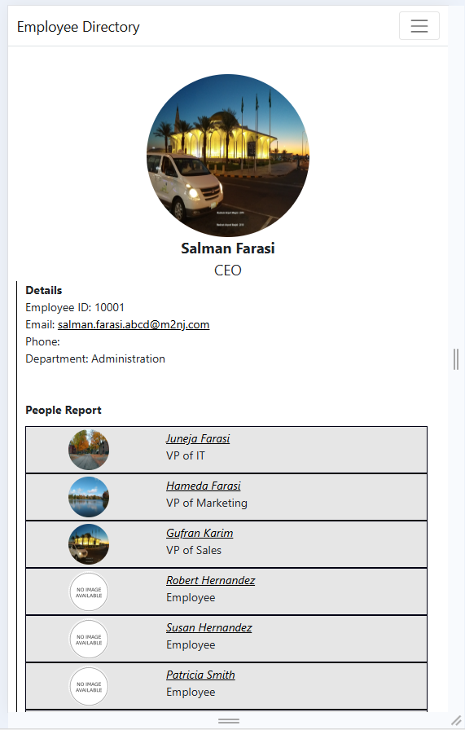
Profile view: Sample 3 (Smaller Screen)

